Slide 1


FATCA & CRS
Compliance Responsibilities for Investment Funds and Managers
April 2026
1
Unlock your way to limitless potential
www.consultinglimitless.com

Slide 2
Overview
UAE has set up separate reporting frameworks under FATCA and CRS, both aimed at preventing tax abuse through foreign accounts and structures. FATCA requires non-US Financial Institutions to report information on US account holders, while CRS covers account holders who are tax residents outside of UAE and US.
Who Is Impacted
FATCA and CRS apply to Financial Institutions, including investment funds, hedge funds, private equity funds, and managers carrying out investment activities. These entities must identify and report accounts held by individuals or entities with tax residency in the US or other CRS countries.
Investment managers may qualify for certain FATCA exemptions, but under CRS, they are generally treated as Financial Institutions with full reporting obligations. UAE funds and managers must carry out due diligence on investors and, where necessary, ultimate beneficial owners, and submit required information to the Ministry of Finance (MoF). Collecting this data also involves privacy considerations, which should be reflected in fund application forms and subscription documents.
Reporting Deadline: The next reporting deadline for FATCA and CRS is set at 30 June 2026 in respect of the reportable accounts for the calendar year of 2016.
2
Unlock your way to limitless potential
www.consultinglimitless.com

Slide 3

Preparing for the Reporting
Deadline
To comply with FATCA and CRS requirements, investment funds and managers should first confirm their correct classification under these regimes. If classified as a Financial Institution, the entity must be properly registered with the IRS for FATCA and with the MoF for both FATCA and CRS.
It is also essential to have all necessary investor self-certifications on file and to complete the required due diligence. This ensures investors are correctly classified, reportable accounts are identified, and the necessary information is collected for reporting.
Therefore, conducting these assessments early allows your fund or management company to accurately fulfil its FATCA and CRS obligations and meet reporting deadlines without issues
3
Unlock your way to limitless potential
www.consultinglimitless.com

Slide 4


How can Limitless Consulting
Help?
Classification
Registration
We help classify your investment fund or management company, review existing classifications, and prepare self-certification forms for your counterparties.
We can handle FATCA registration with the IRS and local FATCA and CRS registration with the Maltese tax authorities.
Investor
Review
Reporting
Limitless supports the submission of FATCA and CRS reports, converting data into the required format and submitting on your behalf. Alternatively, we can provide reporting software for in-house submissions.
Limitless can review your investors’ CRS and FATCA classifications, checking self-certification forms against your KYC documentation.
Self-Certification Forms
We assist in preparing or updating self-certification forms to ensure accurate investor information, and review subscription documents and prospectuses for FATCA and CRS compliance.
4
Unlock your way to limitless potential
www.consultinglimitless.com

Slide 5

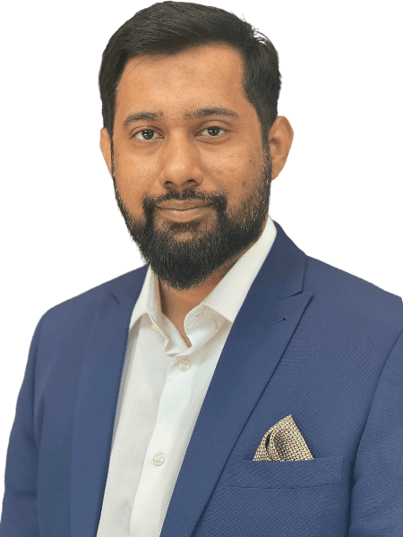
Contact Us
At Limitless, we assist financial and non-financial institutions in managing FATCA and CRS requirements with a clear and practical approach.
Our team brings together experienced professionals from tax, compliance, and advisory backgrounds, with hands-on experience across both local and international FATCA and CRS projects.
We work closely with clients to meet reporting obligations efficiently, without disrupting ongoing operations.
With increasing regulatory expectations, our approach is aligned with broader compliance and advisory services, helping create a more streamlined and consistent framework across all regulatory obligations.
Ms. Mariam Absar Director mariamabsar@consultinglimitless.com
Mr. Emad Bin Saleem Director emad.saleem@consultinglimitless.com
5
Unlock your way to limitless potential
www.consultinglimitless.com

